Slide 1
Do Now
Ilearn Quiz on Minimum Spanning Trees:
Password: icecream

Slide 2
Announcements
Homework 5 is due 4/25/19 (This Thursday). Resubmissions open until 5/2/19.
Exam 2 is 5/14/19.

Slide 3
Exam 2
The best exam yet.
The Class did really well on exam 2!
Average: 87
Std. Deviation: 21
Solutions are up on iLearn. No Exam corrections for this test.
Notes:
To answer this question, let's think about why we use computers instead of people to solve problems.
Human sorting activity: show numbers of items and list of items

Slide 4
Homework
Homework did not see a big bump.
Homework Averages:
HW1: 60%
HW2: 71% (13 people with no submissions)
HW3: 64% (18 no submissions)
HW4: 66% (16 no submission)
HW5: ??
HW6: ??
Notes:
To answer this question, let's think about why we use computers instead of people to solve problems.
Human sorting activity: show numbers of items and list of items

Slide 5
Homework 5 & 6
The class performs better in work done in the classroom.
Good thing for HW5 & HW6 we’re going to have more time in the classroom to work on them.
Starting today!
Notes:
To answer this question, let's think about why we use computers instead of people to solve problems.
Human sorting activity: show numbers of items and list of items

Slide 6
CST 370 – ADVANCED ALGORITHMS
Crush your Coding Interview
Notes:
Today we’re going to talk about time complexity

Slide 7
Objectives
You will be able to…
Explain what an interviewer is looking for in a tech interview.
Identify the main sections of a tech interview and what you should do in each section.
Identify a couple types of questions you might get in an interview.
Explain the steps you should take when solving the problem.
Notes:
So this second mini-lesson will be more of a lab-style. We’re going to practice identifying the time and space complexities of simple algorithms by a method where we count operators.

Slide 8
I’ve seen this before.
There’s two example interview questions at the end of the slides that you can look at an attempt to solve.
You can also work on HW5 independently.
Notes:
To answer this question, let's think about why we use computers instead of people to solve problems.
Human sorting activity: show numbers of items and list of items

Slide 9
I’ve never seen this before.
This class is for you!
ASK LOTS OF QUESTIONS.
Especially if you’re doing a mock interview tomorrow.

Slide 10
What’s the Tech Interview?
Typical timeline.
The typical tech interview is:
About 45-60 min long.
5-10 min of Introductions.
30-40 min of Technical coding problems.
5-10 min Wind-down for you to ask questions about the company.

Slide 11
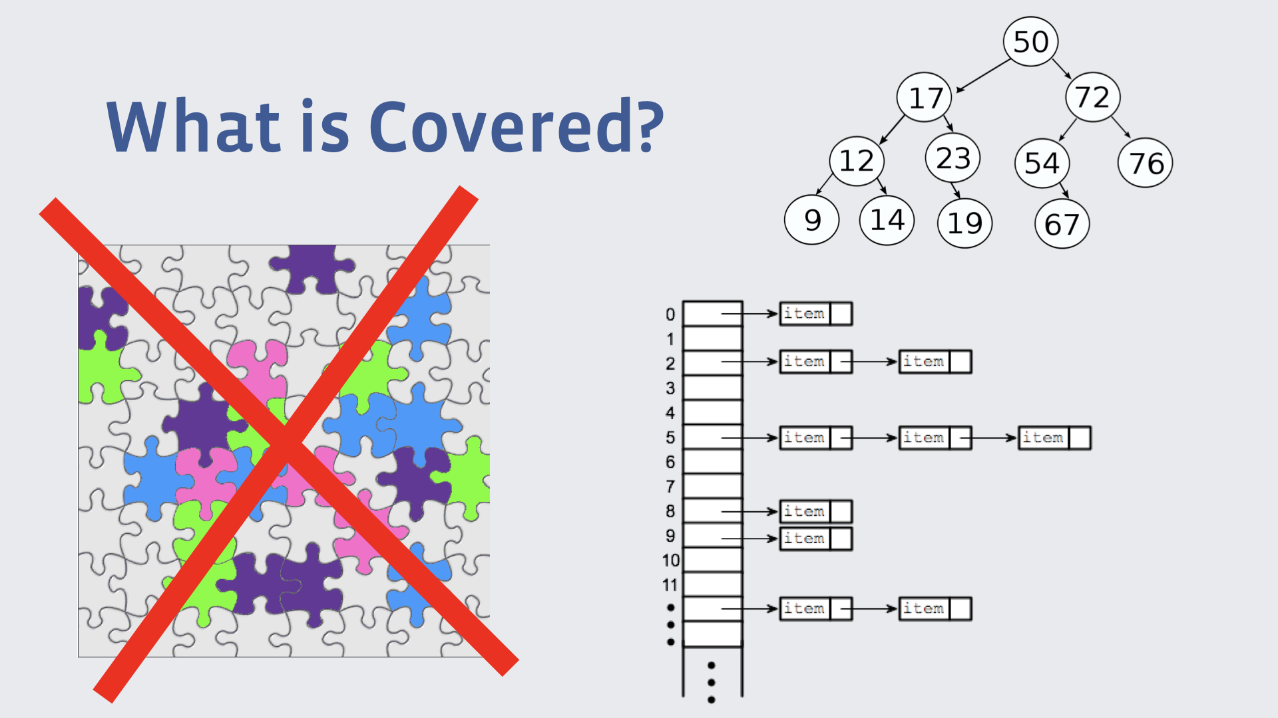
Why the Tech Interview?
What is covered?
Companies are trying to get signal on things we do at work every day
How you think & tackle hard problems.
How you consider engineering trade offs (memory vs time).
How you communicate about code.
What are the limits of what you know.

Slide 12
What is covered?
Data structures & algorithms
Understand, not memorize
Discuss complexity (space & time). Big-O.
Could be re-implementing library functions
Specific questions about concepts are rare
UNLESS you claim to be an expert

Slide 13
What’s the Tech Interview?
Typical timeline.
The typical tech interview is:
About 45-60 min long.
5-10 min of Introductions.
30-40 min of Technical coding problems.
5-10 min Wind-down for you to ask questions about the company.

Slide 14
Introductions
5-10 min of getting comfortable speaking
“Hi my name is Daniel, I will be interviewing you today, I’ve been at <insert company> for ….. Tell me a little about yourself!”

Slide 15
Introductions
5-10 min of getting comfortable speaking
The ice-breaker for the interview.
Use this time to get comfortable talking to each other.
Couple sentences about what you’re passionate about.
Talk about things you wouldn’t mind being asked questions about.

Slide 16
What’s the Tech Interview?
Typical timeline.
The typical tech interview is:
About 45-60 min long.
5-10 min of Introductions.
30-40 min of Technical coding problems.
5-10 min Wind down for you to ask questions about the company.

Slide 17
The coding portion
30-40 min to understand how you think
The meat of the interview. The “technical” in tech interview.
You’ll be given 1-2 problems that you’ll be asked to write code to solve.
In-person / On-site? Coding on a whiteboard.
Over the phone? Coding on a shared website. (like a repl.it or google doc).

Slide 18
The coding portion
30-40 min to understand how you think
There’s generally two types of questions you’d get:
Functional input/output: f(x) = y. Given an input X, write the function F that will produce output Y.
Which function do I write? Given a situation X, write code to produce solution Y.

Slide 19
The coding portion
30-40 min to understand how you think
Regardless what the question is, you should always:
Ask questions to understand the problem
Create your own test cases.
Think about what data structures you’ve seen that can help.
Find a solution before optimizing.
Talk about your solution before coding.

Slide 20
The coding portion
An Example
Given N intervals of the form of [l, r], the task is to find the intersection of all the intervals.
An intersection is an interval that lies within all of the given intervals. If no such intersection exists then print -1.
Input: arr[] = {{1, 6}, {2, 8}, {3, 10}, {5, 8}} Output: [5, 6]
Input: arr[] = {{8, 18}, {1, 7}} Output: -1

Slide 21
The coding portion
30-40 min to understand how you think
Regardless what the question is, you should always:
Ask questions to understand the problem.
Create your own test cases.
Think about what data structures you’ve seen that can help.
Find a solution before optimizing.
Talk about your solution before coding.

Slide 22
Asking Questions
Make sure you understand what’s being asked.
Given N intervals of the form of [l, r], the task is to find the intersection of all the intervals.
Input: arr[] = {{1, 6}, {2, 8}, {3, 10}, {5, 8}} Output: [5, 6]
Input: arr[] = {{8, 18}, {1, 7}} Output: -1
“Will there always be an interval? Are the numbers always positive? Is l always smaller than r?”

Slide 23
The coding portion
30-40 min to understand how you think
Regardless what the question is, you should always:
Ask questions to understand the problem
Create your own test cases.
Think about what daTalk about your solution before coding.
ta structures you’ve seen that can help.
Find a solution before optimizing.
Talk about your solution before coding.

Slide 24
Creating test cases
Further make sure you understand the problem.
Given N intervals of the form of [l, r], the task is to find the intersection of all the intervals.
An intersection is an interval that lies within all of the given intervals. If no such intersection exists then print -1.
Input: arr[] = {{0, 1}, {2, 8}, {3, 10}} Output: -1
Input: arr[] = {{7, 18}, {1, 7}} Output: [7, 7]

Slide 25
The coding portion
30-40 min to understand how you think
Regardless what the question is, you should always:
Ask questions to understand the problem
Create your own test cases.
Think about what data structures you’ve seen that can help.
Find a solution before optimizing.
Talk about your solution before coding.

Slide 26
The coding portion
An Example
Given N intervals of the form of [l, r], the task is to find the intersection of all the intervals.
Input: arr[] = {{1, 6}, {2, 8}, {3, 10}, {5, 8}} Output: [5, 6]
Input: arr[] = {{8, 18}, {1, 7}} Output: -1
“Can I use Maps or Sets? Should I sort anything?”

Slide 27
The coding portion
30-40 min to understand how you think
Regardless what the question is, you should always:
Ask questions to understand the problem.
Create your own test cases.
Think about what data structures you’ve seen that can help.
Find a solution before optimizing.
Talk about your solution before coding.

Slide 28
The coding portion
An Example
Given N intervals of the form of [l, r], the task is to find the intersection of all the intervals.
Input: arr[] = {{1, 6}, {2, 8}, {3, 10}, {5, 8}} Output: [5, 6]
Input: arr[] = {{8, 18}, {1, 7}} Output: -1
“I can look at two intervals at a time. Do I need to keep them in a certain order?”

Slide 29
The coding portion
30-40 min to understand how you think
Regardless what the question is, you should always:
Ask questions to understand the problem.
Create your own test cases.
Think about what data structures you’ve seen that can help.
Find a solution before optimizing.
Talk about your solution before coding.

Slide 30
The coding portion
An Example
Given N intervals of the form of [l, r], the task is to find the intersection of all the intervals.
Input: arr[] = {{1, 6}, {2, 8}, {3, 10}, {5, 8}} Output: [5, 6]
Input: arr[] = {{8, 18}, {1, 7}} Output: -1
“Sort intervals by l. Look at [l1,r1] and [l2, r2]. If l2 < r1, the intersection is [max(l1, l2), min(r1, r2)]. Should I start coding?”

Slide 31
The coding portion
30-40 min to understand how you think
What about the other type of question?
Which function do I write? Given a situation X, write code to produce solution Y.

Slide 32
The coding portion
30-40 min to understand how you think
What about the other type of question?
Can be scary because they lack no solid foundation…
But almost always there is a graph or tree problem lurking behind them.

Slide 33
The coding portion
An Example
A compiler can only compile a file if that file’s “#include<>” files have already been compiled. Write code to determine if a set of files can be compiled.

Slide 34
The coding portion
An Example
A compiler can only compile a file if that file’s “#include<>” files have already been compiled. Write code to determine if a set of files can be compiled.
It’s just a topological sort problem!

Slide 35
The coding portion
30-40 min to understand how you think
Regardless what the question is, you should always:
Ask questions to understand the problem.
Create your own test cases.
Think about what data structures you’ve seen that can help.
Find a solution before optimizing.
Talk about your solution before coding.

Slide 36
Tips & Advice
Things to keep in mind
You don’t have to code everything!

Slide 37
Tips & Advice
Things to keep in mind
You don’t have to code everything!
Assume you can use your programming language’s standard library:
Vectors, Stacks, Queues, Heaps.
Maps, Sets.
Sorting.

Slide 38
Tips & Advice
Things to keep in mind
You don’t have to code everything!
Ask if you can assume helper functions exist.
We want to see you solve the problem you’re given.

Slide 39
Tips & Advice
Things to keep in mind
You don’t have to code everything!
Ask if you can assume helper functions exist.
We want to see you solve the problem you’re given.
You’re code doesn’t need perfectly compile.

Slide 40
Tips & Advice
Things to keep in mind
Talk out loud. Interviewers trying to see how you tackle hard problems.

Slide 41
Tips & Advice
Things to keep in mind
Talk out loud. Interviewers trying to see how you tackle hard problems.
Draw diagrams, write down notes, etc...

Slide 42
Tips & Advice
Things to keep in mind
Test your code! No one writes bug-free code on the first try.

Slide 43
Tips & Advice
Things to keep in mind
Test your code! No one writes bug-free code on the first try.
Test your code on small examples and given test cases.
Catching a bug while testing is a good thing.

Slide 44
Tips & Advice
Things to keep in mind
Test your code! No one writes bug-free code on the first try.
Test your code on small examples and given test cases.
Catching a bug while testing is a good thing.
Write notes / comments when testing code.

Slide 45
Tips & Advice
Things to keep in mind
Switch between writing code and explaining the algorithm when stuck.

Slide 46
Tips & Advice
Things to keep in mind
Switch between writing code and explaining the algorithm when stuck.
Stuck on the algorithm? “Let me start by writing the code for what I know while I think about <talk about the issue>. ”

Slide 47
Tips & Advice
Things to keep in mind
Switch between writing code and explaining the algorithm when stuck.
Stuck on the coding? “Let me look at my algorithm again since I’m unsure how to writhe <talk about the issue> in code”

Slide 48
Tips & Advice
Things to keep in mind
You don’t have to code everything!
Talk out loud. Interviewers trying to see how you tackle hard problems.
Test your code! No one writes bug-free code on the first try.
Switch between writing code and explaining the algorithm when stuck.

Slide 49
What’s the Tech Interview?
Typical timeline.
The typical tech interview is:
About 45-60 min long.
5-10 min of Introductions.
30-40 min of Technical coding problems.
5-10 min Wind-down for you to ask questions about the company.

Slide 50
The Wind down
Have 1 or 2 questions prepared for the interviewer
You are interviewing the company as well, is this somewhere you’d like to be?
Focus on what matters most to you
- Contact the recruiter with any questions or follow ups
- Pat yourself on the back for a job well done!

Slide 51
Resources
Practice Practice Practice!
Cracking the coding interview book
Video from Facebook
Other articles:
Get That Job at Google, Steve Yegge Blog ← if you only read one, read this one... it's strangely seen as a seminal text wrt interview prep ¯\_(ツ)_/¯
Always Be Coding, The Muse
The Coding Interview, Palantir
How to Ace Your Technical Interview, Forbes
Ace the Coding Interview Every Time, Medium
The Ultimate Guide to Acing Your Technical Interview

Slide 52
Example Questions
For you to work on.
Given an array of size N in which every number is between 1 and N, determine if there are any duplicates.
Input: [2,3,1] Output: false
Input: [1,2,2,4] Output: true

Slide 53
Example Questions
For you to work on.
You are given a keyboard with fours keys: the letter a, select all, copy, and paste. What is the maximum number of letters you can produce with 17 keystrokes?

